Slide 1
Business Data Transformations – Homework 4.2
Dr. Pawel Kalczynski

Slide 2
Dr. K.’s Quarterly GDP Growth Forecast Competition
One-Step GDP Growth Forecast
All quarters 2007-Qtr1 to the most recent available must be included in the evaluation
The author of the best (confirmed) forecast in the class will receive:
- Extra credit 50pts but no more than 50 pts total
The new best-known forecast must show the lowest value of MASE (Mean Absolute Scaled Error) for the analyzed period.
Disqualification from the competition: errors, different random seed, irreproducibility, unlagged predictors, not using keras, not using FRED on Quandl. Period-specific transformations (e.g. specific to 2008-Qtr3) will also result in 0pts. for the HW. Note that smoothing, which does not depend on specific periods, is OK.

Slide 3
Tasks to Complete
T4.1: Use Quandl to download all available quarterly GDP (GDPC1) data from FRED and all selected predictors – prepare an xts object with GDP (predicted) in the first column. Do not transform (lag, detrend, etc.) this structure – it must contain data as reported by FRED.
T4.2: Prepare a machine-learning function using keras in R (or Python):
oneStepGDPGrowthForecast<-function(time.series.xts)
that returns the single value (growth forecast) for the variable in the first column for the specified time period using the remaining columns as predictors.
You must run keras:: use_session_with_seed(1,disable_gpu=T,disable_parallel_cpu = T,quiet=T) or tensorflow::tf$random$set_seed(1) one line before setting up the model in keras
Remember to transform variables as needed, e.g. log(t1)-log(t0), and to lag the predictors!
T4.3: Use your function to generate a backtest for all quarters 2007 Qtr 1 until now - run your function in a loop – I know this is inefficient but it will allow for accurate testing.
T4.4: Plot the actual and forecast quarterly GDP growth values since 2007 Qtr1. List the symbols of your predictors . Report MASE.

Slide 4
Requirements
Submit a single PDF file (not a zipped folder!) with answers to each question and the SQL or R code (also for any views) in a textbox. See the template on the next slide.
You may not use just the same two predictors that were used in the example, i.e., UNRATE, and CPIAUCSL lagged by 1 period (you must add at least one symbol and/or lag; you may also remove one or both symbols).
Note: for this assignment all code (the entire code for the oneStepGDPForecast function) must be in the appendix
Note: If you did not use SQL or R code, explain in the textbox which tools you used to get the result.

Slide 5
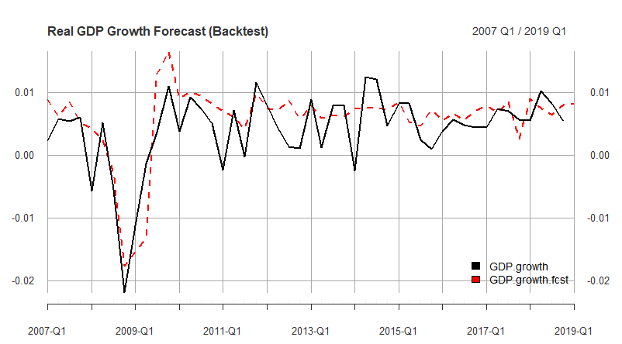
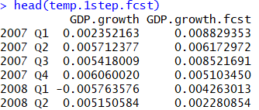
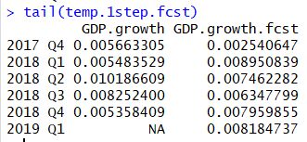
Template
[First Name] [Last Name]
Q4.4:
The chart should look like:
The expected output:
Predictors’ FRED symbols: UNRATE, CPIAUCSL, T10Y2Y, …
MASE= #.### (for the image above MASE=0.7136075)
oneStepGDPGrowthForecast <- function(time.series.xts){
…
}

